Slide 1
Synchronization Tools
Course Code: CSC 2209
Course Title: Operating Systems
Dept. of Computer Science
Faculty of Science and Technology
Lecturer No: | 08 | Week No: | 08 | Semester: | Summer 22-23
Lecturer: | Taslimur Rahman; Taslimur.Rahman@aiub.edu

Slide 2
Lecture Outline
Background
The Critical-Section Problem
Peterson’s Solution

Slide 3
Background
Processes can execute concurrently
May be interrupted at any time, partially completing execution
Concurrent access to shared data may result in data inconsistency
Maintaining data consistency requires mechanisms to ensure the orderly execution of cooperating processes
Illustration of the problem: Suppose that we wanted to provide a solution to the consumer-producer problem that fills all the buffers. We can do so by having an integer counter that keeps track of the number of full buffers. Initially, counter is set to 0. It is incremented by the producer after it produces a new buffer and is decremented by the consumer after it consumes a buffer.

Slide 4
Producer
while (true) { /* produce an item in next produced */
while (counter == BUFFER_SIZE)
; /* do nothing */
buffer[in] = next_produced;
in = (in + 1) % BUFFER_SIZE;
counter++;
}

Slide 5
Consumer
while (true) {
while (counter == 0)
; /* do nothing */
next_consumed = buffer[out];
out = (out + 1) % BUFFER_SIZE;
counter--;
/* consume the item in next consumed */
}

Slide 6
Race Condition
A race condition is an undesirable situation that occurs when a device or system attempts to perform two or more operations at the same time, but because of the nature of the device or system, the operations must be done in the proper sequence to be done correctly.
A race condition occurs when two or more threads can access shared data and they try to change it at the same time.
Notes:
Var balance = 10; (Global)
Process 1 {
Modify balance … 10 -5 = 5
Jljlk
kljlkjlk
}
Process 2 {
Balance modify 10—5 = 5
Lkjlkj
kljlkj
}

Slide 7
Race Condition
counter++ could be implemented as register1 = counter register1 = register1 + 1 counter = register1
counter-- could be implemented as register2 = counter register2 = register2 - 1 counter = register2
Consider this execution interleaving with “count = 5” initially:
S0: producer execute register1 = counter {register1 = 5} S1: producer execute register1 = register1 + 1 {register1 = 6} S2: consumer execute register2 = counter {register2 = 5} S3: consumer execute register2 = register2 – 1 {register2 = 4} S4: producer execute counter = register1 {counter = 6 } S5: consumer execute counter = register2 {counter = 4}

Slide 8
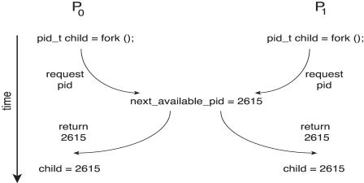
Race Condition
Processes P₀ and P₁ are creating child process using the fork() system call
Race condition on kernel variable next_available_pid which represents the next available process identifier (pid)
Unless there is mutual exclusion, the same pid could be assigned to two different processes!
Notes:
P0 = fork(p0)
P1 = fork(p1)
Fork (process ) {
Return new _process_id; //
}
P0 GOT A CHILD PROCESS WITH ID 110
P1 GOT A CHILD PROCESS WITH ID 110

Slide 9
Critical Section Problem
Consider system of n processes {p₀, p₁, … p_{n-1}}
Each process has critical section segment of code
Process may be change common variables, updating table, writing file, etc.
When one process is in critical section, no other process may be in its critical section
Critical section problem is to design protocol to solve this
Each process must ask permission to enter critical section in entry section, may follow critical section with exit section, then remainder section

Slide 10
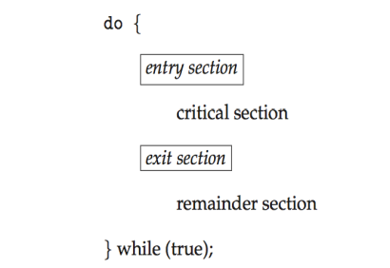
Critical Section
General structure of process P_{i}
Notes:
P1 {
Entry code {
}
Criticial section {
Common change ..data update.. Table delete common sensative data
}
Exit code {
}
Others code{
}
}
P2 {
Entry code {
}
Criticial section {
Common change ..data update.. Table delete common sensative data
}
Exit code {
}
Others code{
}
}

Slide 11
Solution to Critical-Section Problem (Conditions/Laws/Properties)
1. Mutual Exclusion - If process P_{i} is executing in its critical section, then no other processes can be executing in their critical sections
2. Progress - If no process is executing in its critical section and there exist some processes that wish to enter their critical section, then the selection of the processes that will enter the critical section next cannot be postponed indefinitely (stopping each other)
3. Bounded Waiting - A bound must exist on the number of times that other processes are allowed to enter their critical sections after a process has made a request to enter its critical section and before that request is granted
Assume that each process executes at a nonzero speed
No assumption concerning relative speed of the n processes
Notes:
Conditions/ Laws/Properties

Slide 12
Critical-Section Handling in OS
Two approaches depending on if kernel is preemptive or non- preemptive
Preemptive – allows preemption of process when running in kernel mode
Non-preemptive – runs until exits kernel mode, blocks, or voluntarily yields CPU
Essentially free of race conditions in kernel mode

Slide 13
Peterson’s Solution
Not guaranteed to work on modern architectures! (But good algorithmic description of solving the problem)
Maximum Two process solution (drawbacks)
Assume that the load and store machine-language instructions are atomic; that is, cannot be interrupted
The two processes share two variables:
int turn;
boolean flag[2];
The variable turn indicates whose turn it is to enter the critical section
The flag array is used to indicate if a process is ready (interested) to enter the critical section. flag[i] = true implies that process P_{i} is ready!
Notes:
https://en.wikipedia.org/wiki/Peterson%27s_algorithm
Flag [1] = true
Turn = 1

Slide 14
Algorithm for Process P_{i}
while (true){
flag[i] = true;
turn = j; // vice-versa
while (flag[j] && turn = = j){
};
/* critical section */
flag[i] = false; // Exit section
/* remainder section */
}
Notes:
While ( Flag [i] = false and turn = i ) {}. …// second process
Critical section using ….; first process
Exit code …. Flag [i] = false
Flag = interested
Initially Flag [0/1] = both false
If 1 of them is false in while loop enter in CS
Now preempt turn is for Pj…both condition true now in loop
Now Pi execute exit section make no interest … Pj keep trying in loop ..suddenly get out of the loop and enter CS

Slide 15
Peterson’s Solution (cont’d)
Provable that the three CS requirement are met:
1. Mutual exclusion is preserved
P_{i} enters CS only if:
either flag[j] = false or turn = i
2. Progress requirement is satisfied
3. Bounded-waiting requirement is met
Notes:
Initially all false
1 process make 1 true and overcome loop and enter CS
Another process stuck in the loop and keep trying
Process 1 out of CS and change condition exit section
Now another process go out of the loop and enter CS

Slide 16
Peterson’s Solution
Although useful for demonstrating an algorithm, Peterson’s Solution is not guaranteed to work on modern architectures.
Understanding why it will not work is also useful for better understanding race conditions.
To improve performance, processors and/or compilers may reorder operations that have no dependencies.
For single-threaded this is ok as the result will always be the same.
For multithreaded the reordering may produce inconsistent or unexpected results!

Slide 17
Peterson’s Solution
Two threads share the data: boolean flag = false; int x = 0;
Thread 1 performs while (!flag) ; print x
Thread 2 performs x = 100; flag = true
What is the expected output?

Slide 18
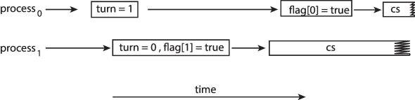
Peterson’s Solution
100 is the expected output.
However, the operations for Thread 2 may be reordered: flag = true; x = 100;
If this occurs, the output may be 0!
The effects of instruction reordering in Peterson’s Solution
This allows both processes to be in their critical section at the same time!

Slide 19
Books
Operating Systems Concept
Written by Galvin and Silberschatz
Edition: 9th

Slide 20
References
Operating Systems Concept
Written by Galvin and Silberschatz
Edition: 9th

